Slide 1

Decarbonizing New England
How Electricity Can Enable Our Future
Restructuring Roundtable
Dan Dolan
June 12, 2020

Slide 2
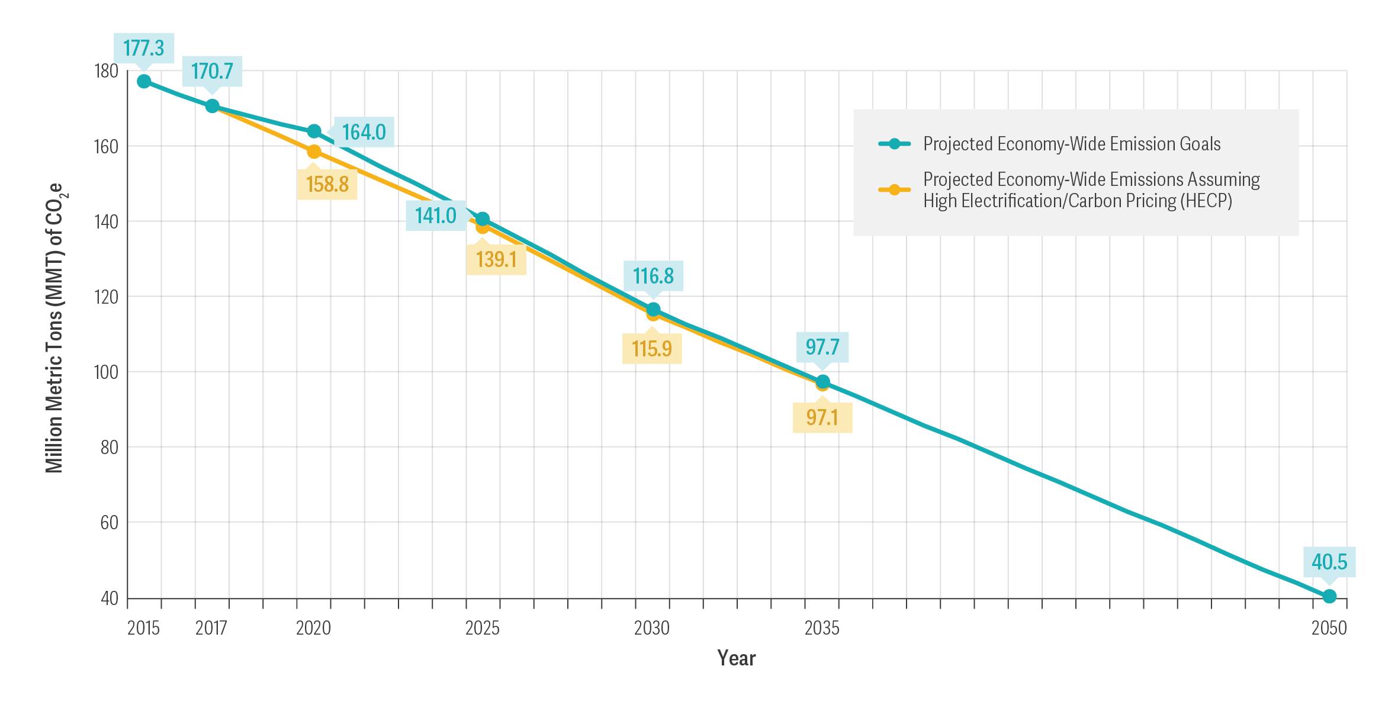
New England CO₂ emissions goals & a pathway to get there

Slide 3
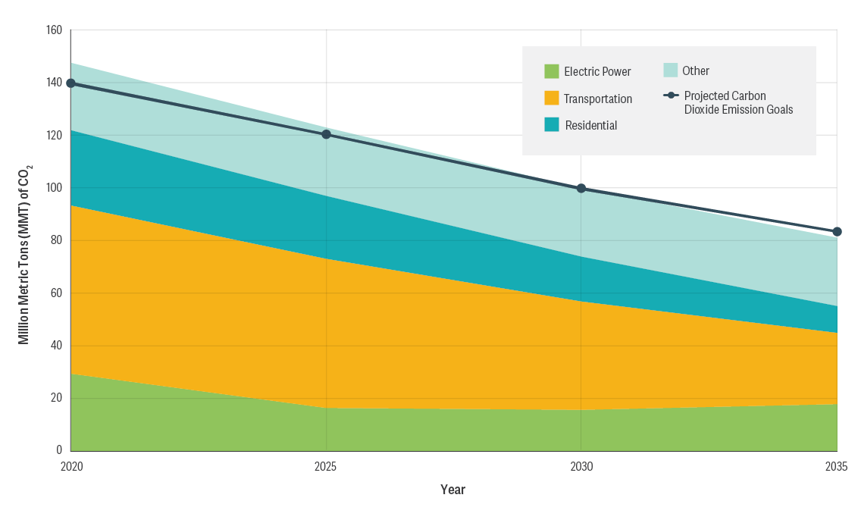
Economic sector emissions profiles with high electrification/CO₂ price

Slide 4
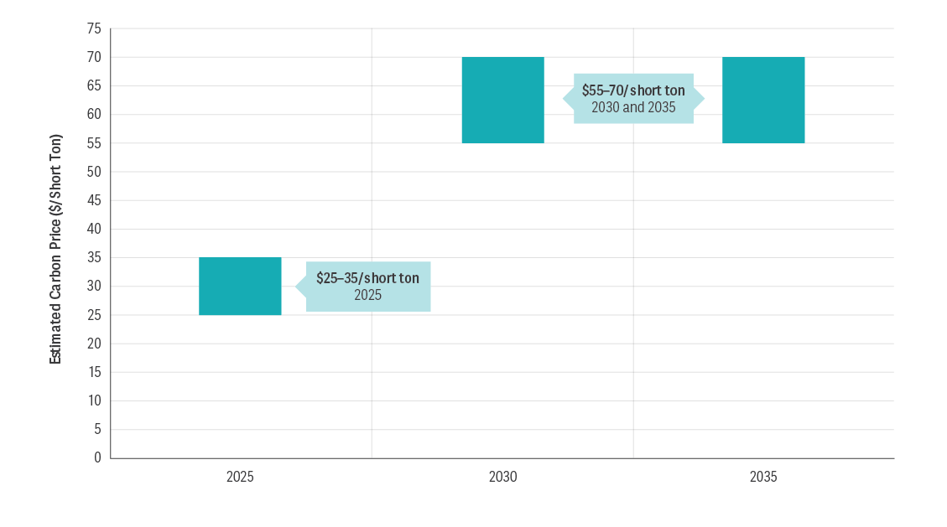
New England CO₂ prices sufficient to meet state emissions requirements

Slide 5
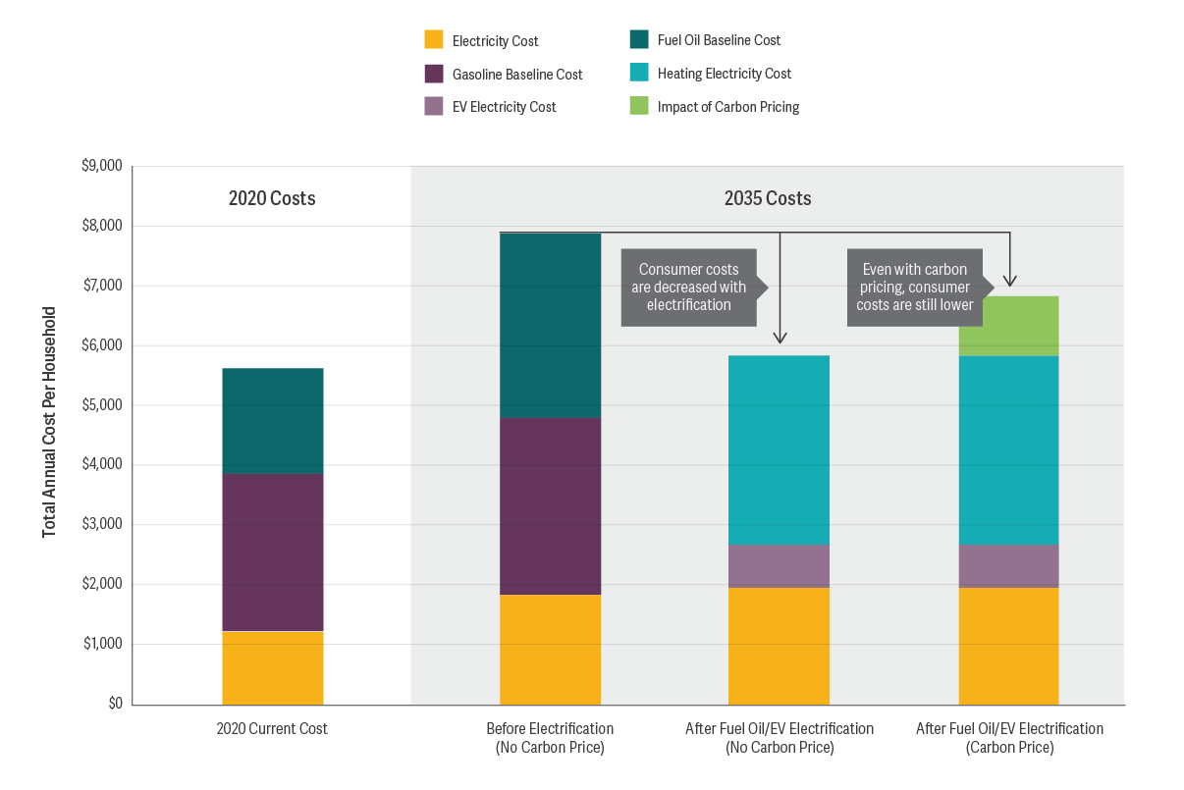

Slide 6
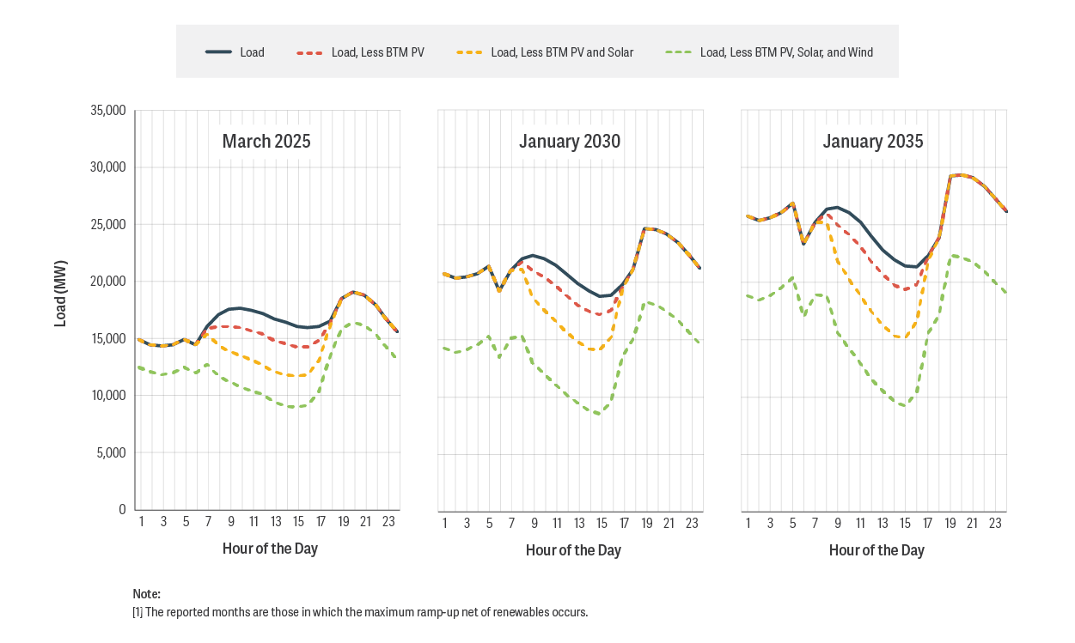
Electric ramp rates with high electrification in transportation and heating

Slide 7
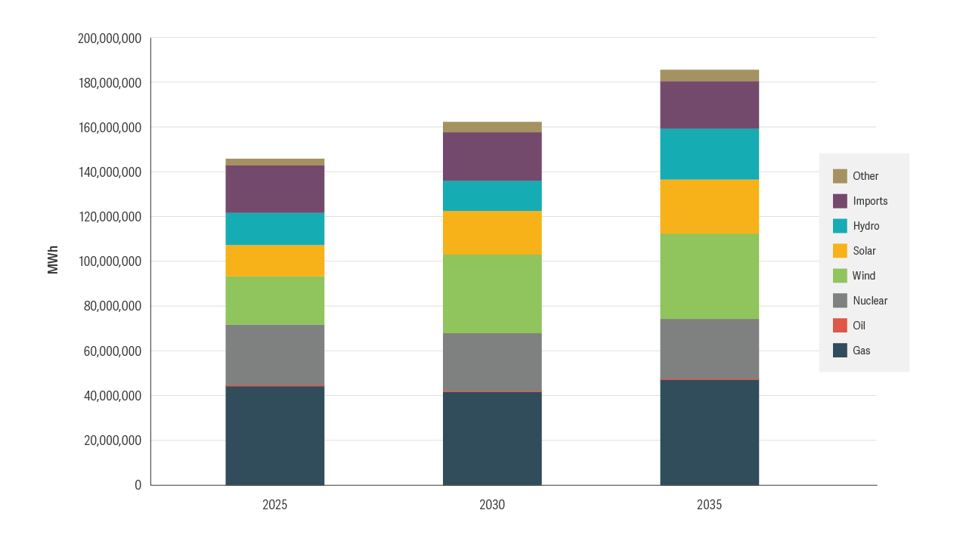
Electric resource mix to meet emissions trajectory & supported by CO₂ price

Slide 8
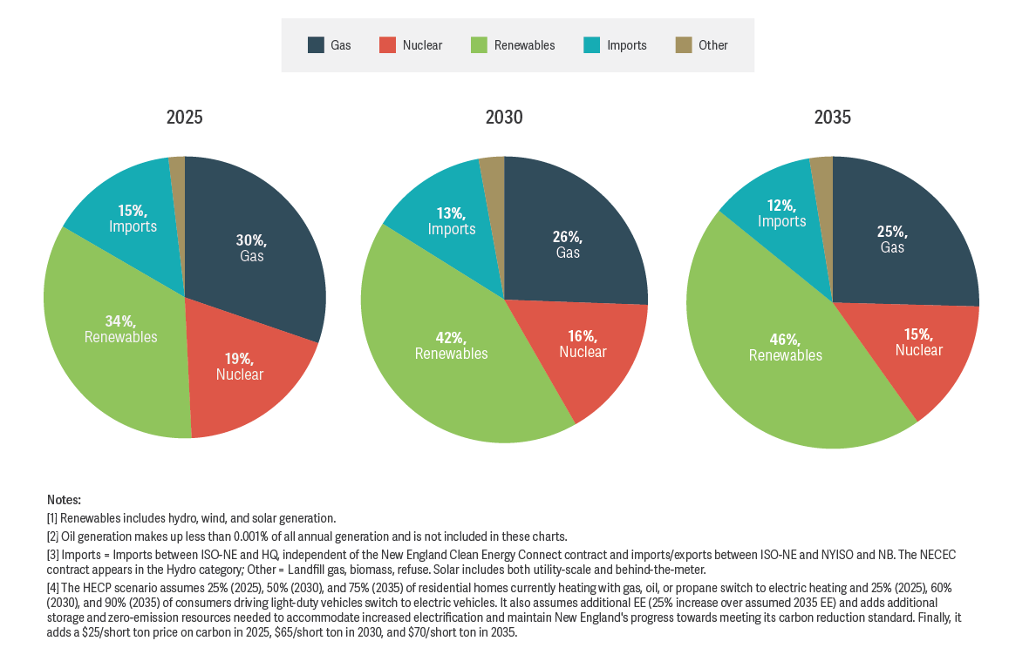

Slide 9
New England power plant CO₂ emissions from 1990 to 2017
55% Decrease since 1997
50% Decrease since 1990
Source: http://www.eia.gov/environment/emissions/state/, released October 23, 2019

Slide 10

www.NEPGA.org
@NEPowerGen

